Slide 1



Starting in 15 minutes
Electrical Engineering Department
Academic Year: 2025/2026
Semester: One
25CPES102
Electronic Materials and Devices
Lecture 5
Operational Amplifiers
Prepared by:
Dr. Sameh Osama Ezzat Abdellatif
PhD, Nano-semiconductor devices and photonics
Lecturer @ BUE
Start

Slide 2

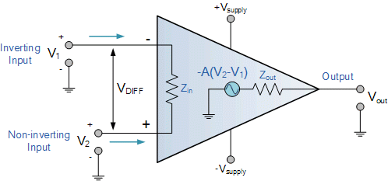

Electronics Levels
Sub-transistor Level
Gate/IC Level
Transistor Level

Slide 3
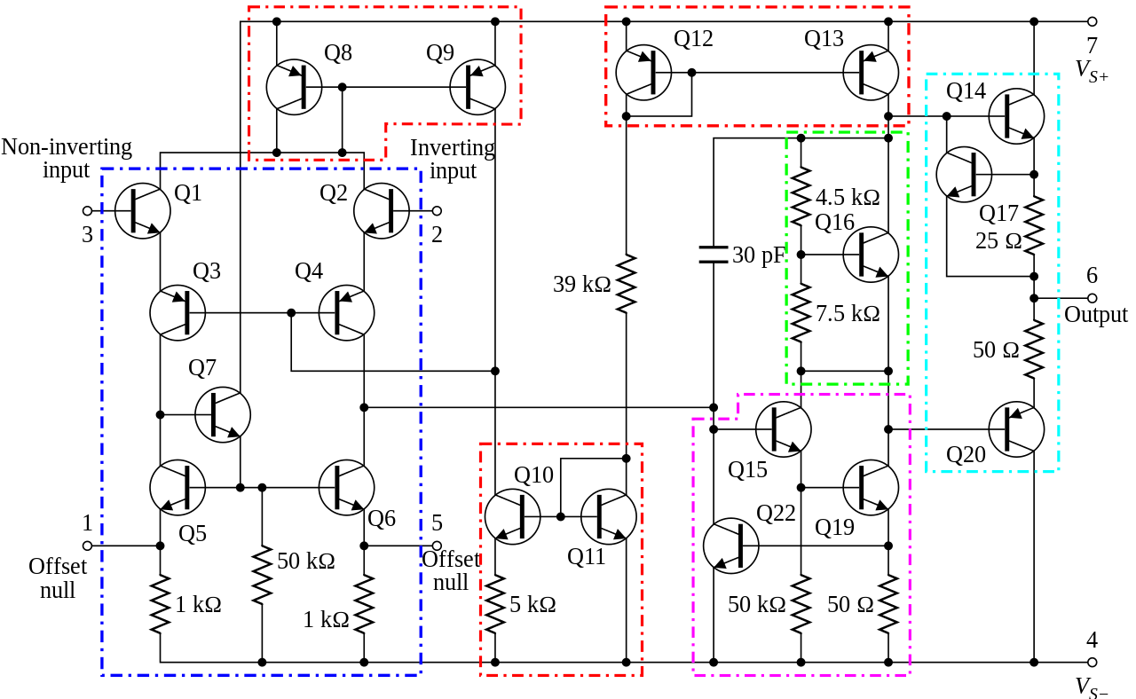
What’s inside?
Op Amp

Slide 4
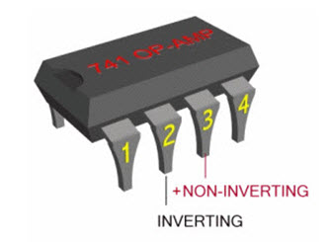
Op Amp as an IC
Op Amp

Slide 5
Op Amp
The open loop gain

Slide 6
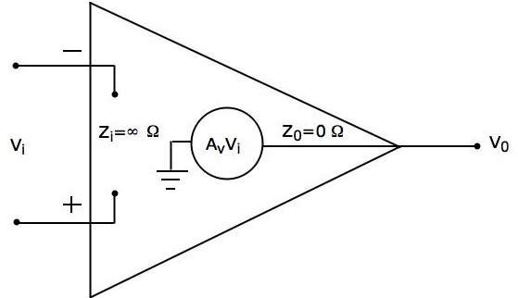
Ideal Op Amp

Slide 7
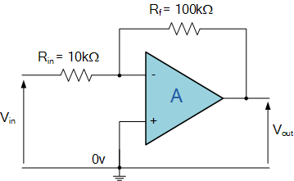
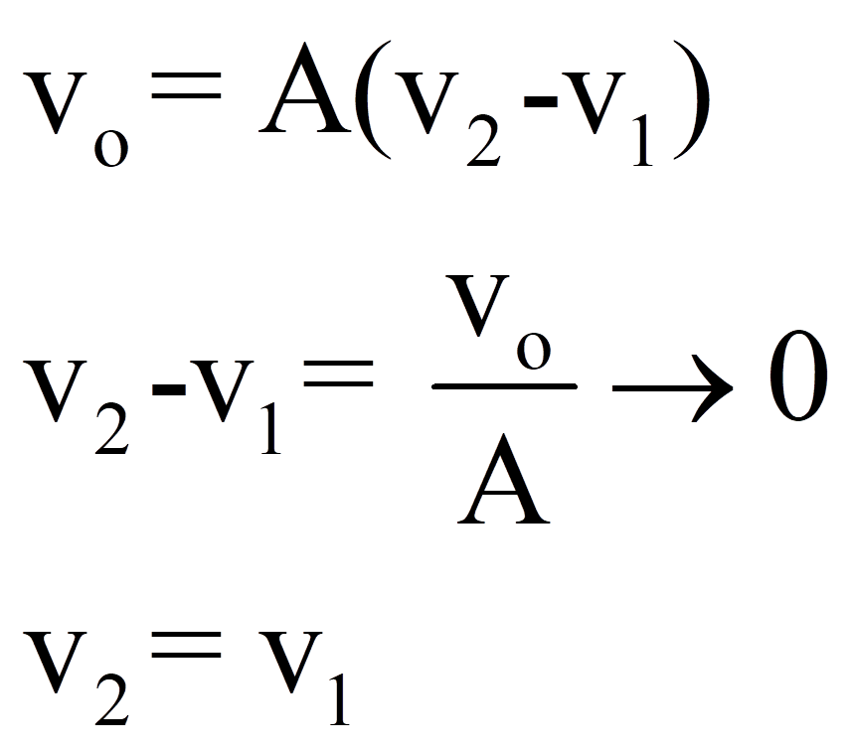
The Inverting Configuration
R₂
R₁

Slide 8
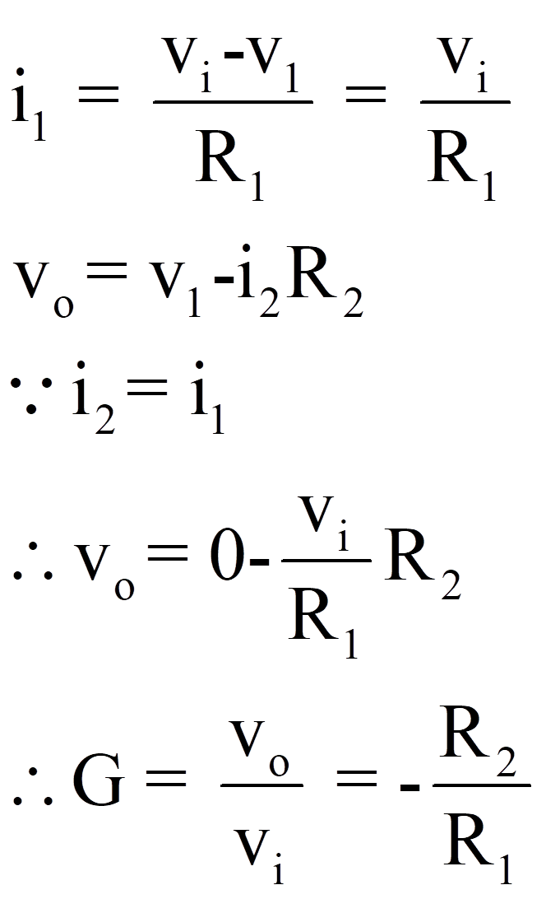
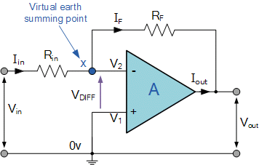
The Inverting Configuration
R₂
R₁
The closed loop gain

Slide 9
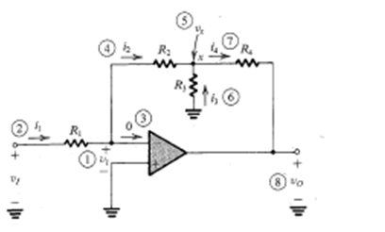
The Inverting Configuration
Example

Slide 10
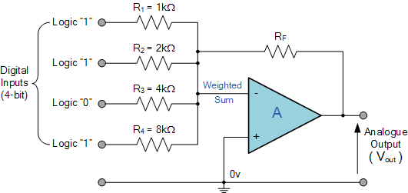
The Weighted Summer
R₁
R₂
R₃
R_{n}

Slide 11
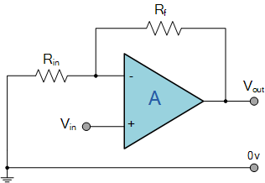
The Non-inverting Configuration

Slide 12
The Voltage Follower

Slide 13
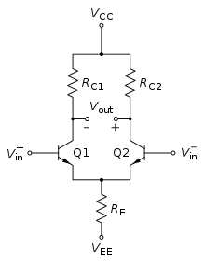
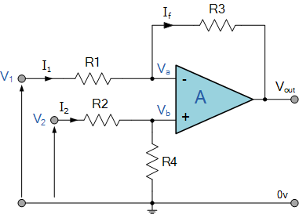
Difference Amplifiers
R2
R3

Slide 14
Difference Amplifiers
R2
R3

Slide 15
Difference Amplifiers
R2
The Common Mode Rejection Ratio CMRR
R3

Slide 16
Difference Amplifiers
R2
Superposition
R3
The same gain is seen by the two input terminals

Slide 17
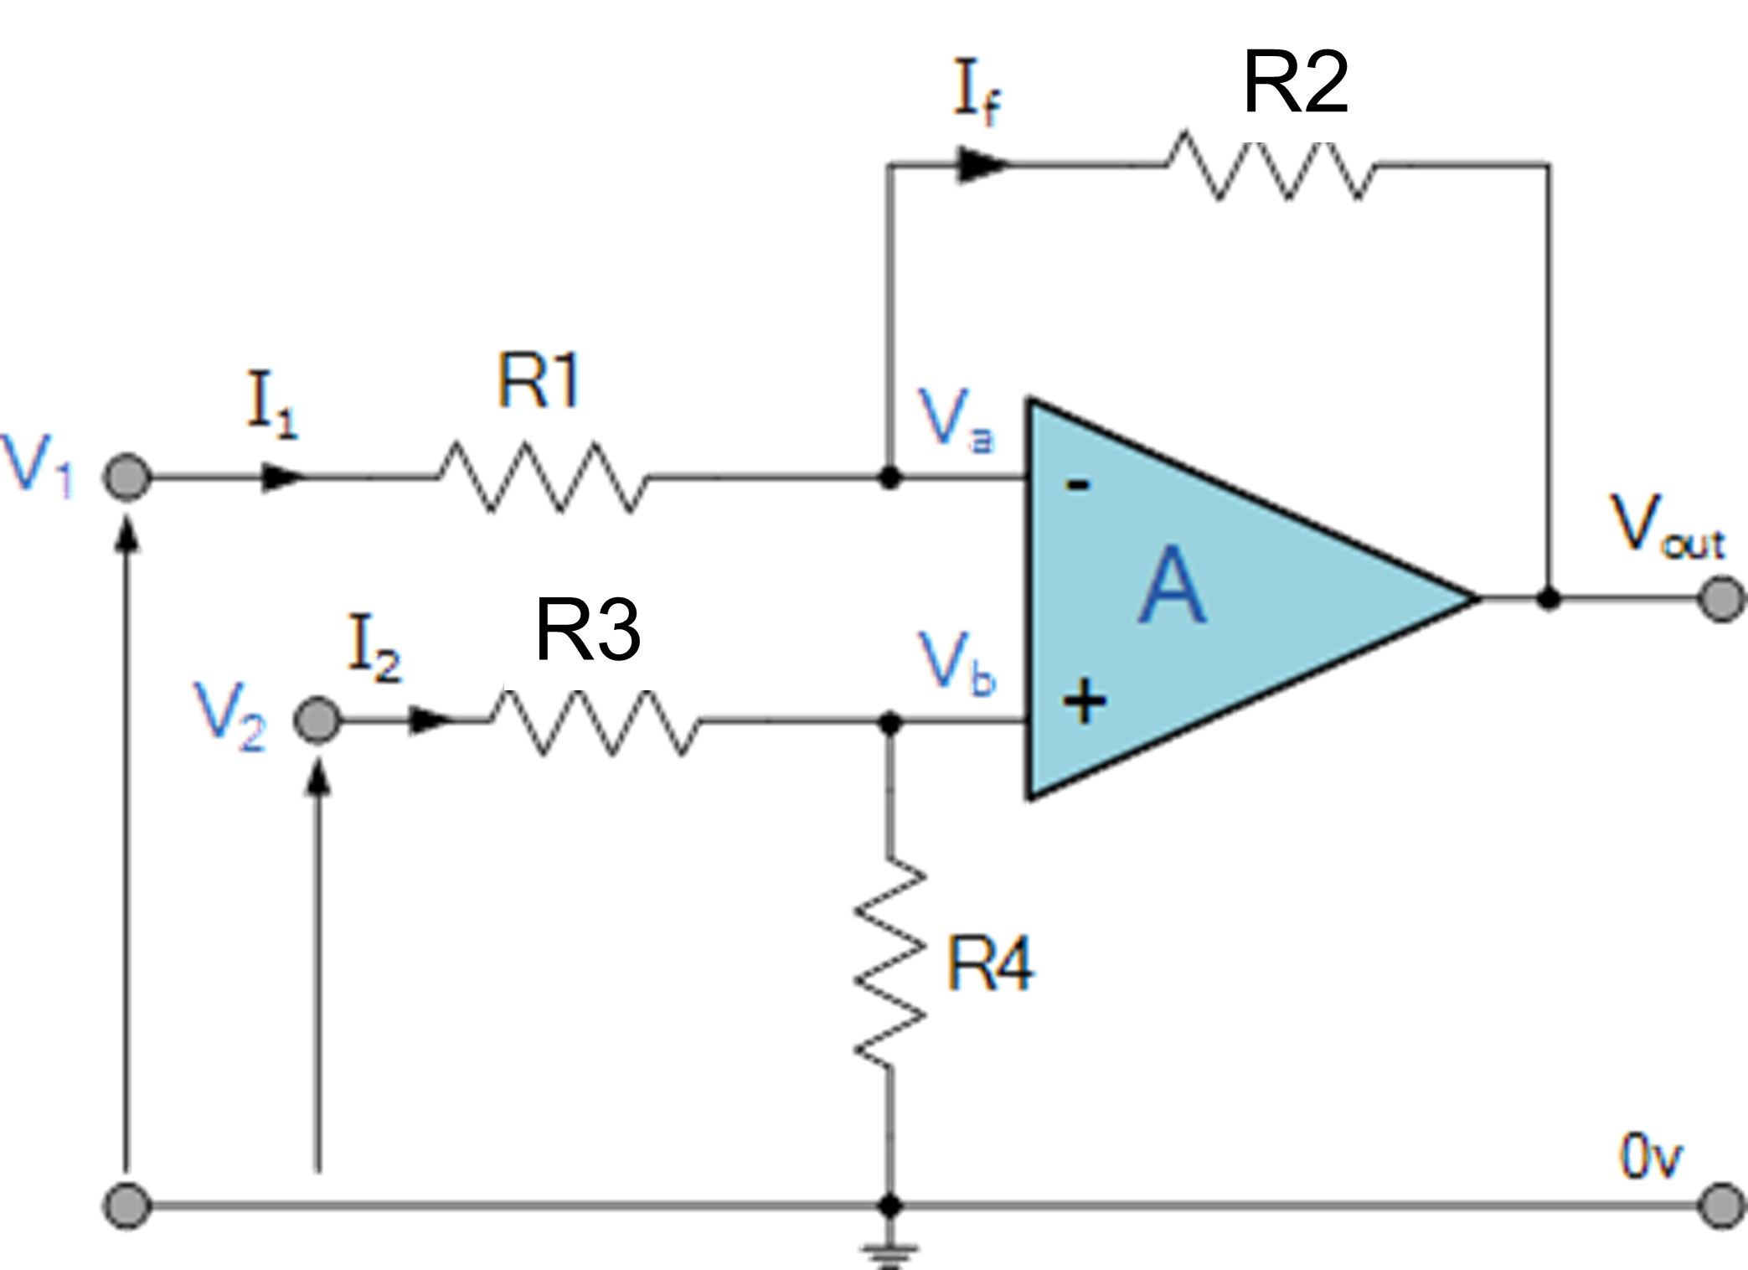
Difference Amplifiers
Differential Gain

Slide 18
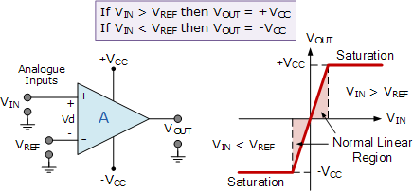
Output Voltage Saturation

Slide 19
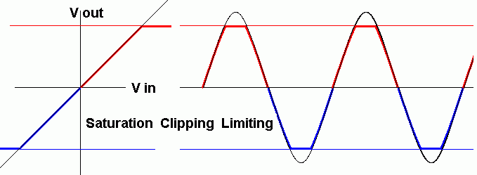
Output Voltage Saturation

Slide 20
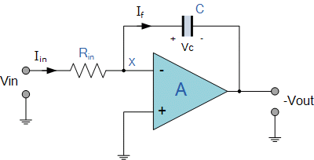
The Inverting Integrator

Slide 21
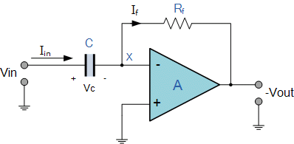
The Op Amp Differentiator

Slide 22
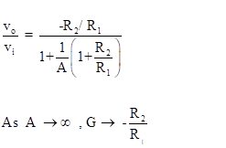
Effect Of Finite Open Loop Gain
Wrong assumption
R₂
R₁

Slide 23

Thank You
© 20ECE05C; Electronics (1), Dr. Sameh Osama

